Slide 1
Optimizing Data Delivery for Ground Vehicle Teams
Jafar Al-Gharaibeh, Ph.D.
Jordan Bonney
DISTRIBUTION STATEMENT A.
Approved for public release; distribution is unlimited.

Slide 2
Tactical Networking Challenges
The DIL Problem
  Disconnections happen; tactical comms links are wireless
  Intermittency is a reality; tactical comms nodes are mobile
  Limited bandwidth, especially when
    Near transmission-range limits
    Employing extreme anti-jam algorithms
    Using legacy waveforms (e.g., ANW2, CDL, Link-16/JREAP-C, ROVER, TTNT)
Waveform Diversity
  There’s no singular “best” waveform
  Legacy waveforms need to be integrated with newer equipment
IP Addressing
  Often duplicated across hardware platforms to simplify manufacturing/production
  Motivates the need for Network Address Translation (NAT) and service discovery
Multicast: The Misunderstood Necessity
  Provides transmission efficiency when streaming to multiple consumers
  As network complexity increases, you may need more than just IGMP (e.g., PIM)

Slide 3
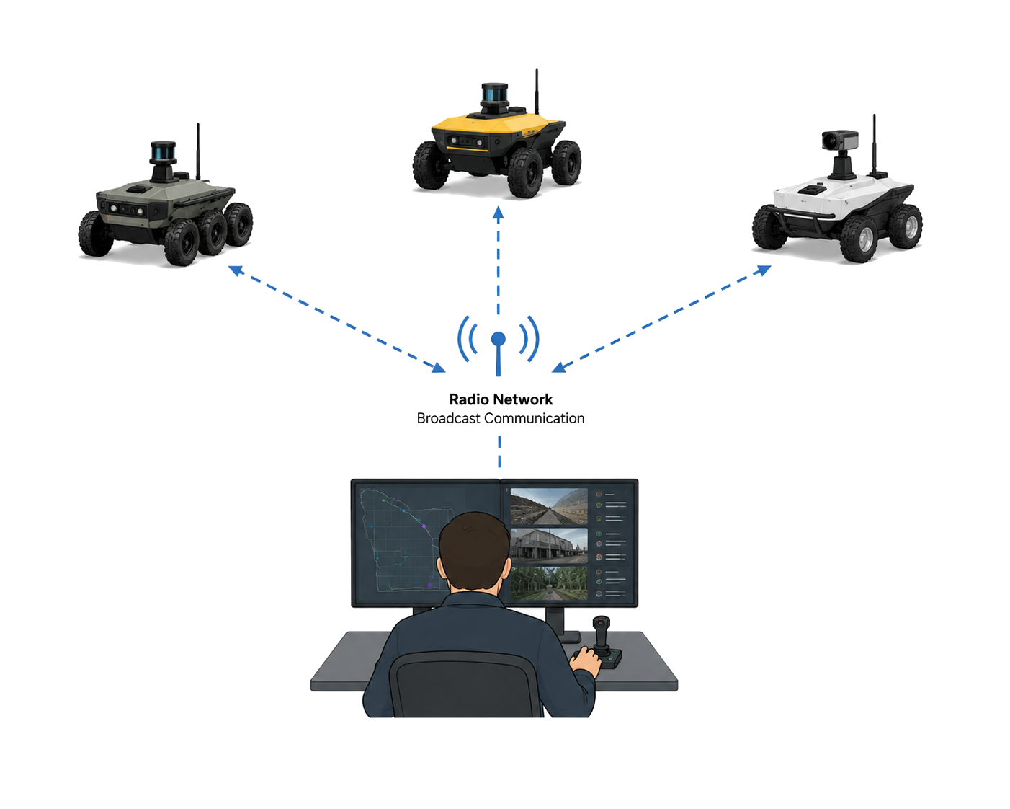
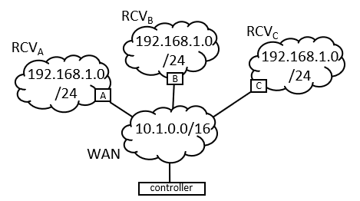

Remote Control Vehicle (RCV) Comms
  Even simple use cases present challenges
Single controller, multiple RCVs, and IP address duplication
  Each RCV’s payload has the same internal “LAN” addresses as the other RCVs
    Not a requirement, but a reality of how RCV payloads are built
  Network Address Translation (NAT) is provided by each RCV
  Controller “knows” the WAN-side address of each RCV (no higher-level service discovery)
RCV_{B}
RCV_{C}
RCV_{A}
controller

Slide 4

One-to-One NAT’ing
Controller maps RCVs’ unique WAN addresses to corresponding duplicate LAN addresses
  Assume each RCV has a camera at the same LAN address that the controller accesses through a unique WAN address
RCV Camera LAN IP Camera WAN IP
A 192.168.1.3 10.1.3.3
B 192.168.1.3 10.1.2.3
C 192.168.1.3 10.1.1.3

Slide 5
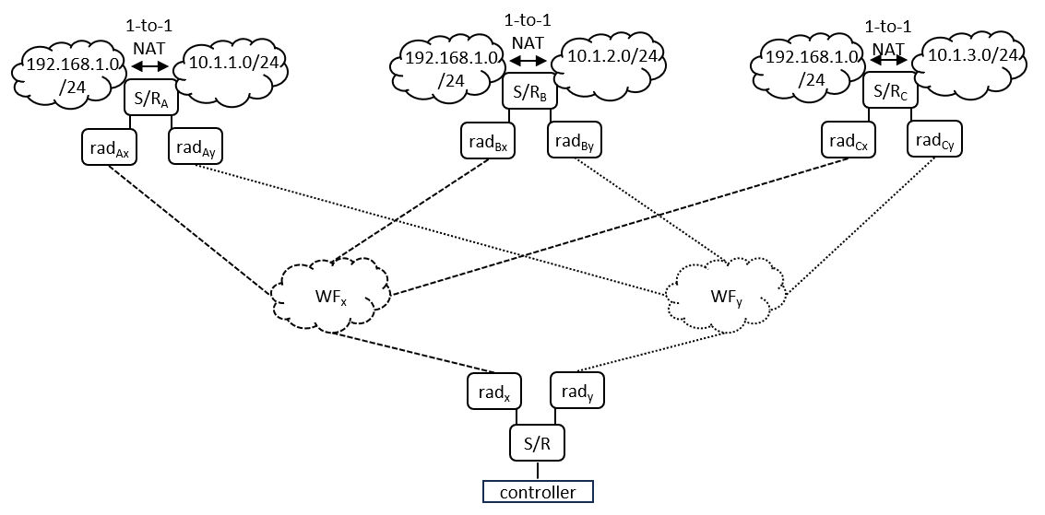
Impact of Radio Links
  Unlike wired links, RF link quality changes
RF link quality is a function of RSS
  The “best” link at one moment might be the worst later
Waveform diversity can be used to improve availability and throughput
  Different frequencies, modulation, and antennas placed at different locations on vehicles
  Philosophy: if one link is degraded, another might be better

Slide 6
Dynamic Link Sensing
  Determining which RF link is best at a given moment
Link-quality can be determined by
  Radio feedback (like DLEP) that influences Layer-3 routing choices
  Active probing by switch/routers
Link-quality metrics (especially capacity) can be used to
  Load balance flows across multiple waveforms
  Suppress “big” flows that would otherwise exceed available link capacity
Which way’s better?
Link sensing figures it out.

Slide 7
Simplifying Configuration
Link sensing and load balancing (aka radio-aware routing) usually requires twisting a lot of knobs (configuring many parameters)
Machete underlay links simplify radio-aware-routing configuration
  Single-line change to configuration specifies the underlay link type
  Link sensing and load balancing is automatically invoked
  No Layer-3 routing protocol overhead (or configuration) is incurred
  Designed for relatively flat networks that have multiple RF paths between edge networks

Slide 8
Next Steps
Implement simulations
  Up to 32 RCVs
  Two or three RF paths
  Vary RF link capacity over simulation time
Measure
  Link-sensing accuracy
  Load balancing agility
  Network overhead
  Scalability in terms of
    Max flows
    Max RCVs

